Slide 1

Covid-19 analysis
Denis doci, steven Aiello, Todd orrender

Slide 2
Background
COVID-19 has become perhaps the largest public health crisis of the last century
The impacts of the virus have decimated the well-being of the world’s population and stricken the global economy. The extent of these damages are still unknown
Amidst the panic and misinformation, there is a dire need for greater understanding of the consequences of the virus through data-driven approaches
In this presentation, we try to disseminate conclusions about the impacts of the virus to offer clarity in these uncertain times

Slide 3
Main questions
How is the USA dealing with the virus compared to other countries ?
Is Sweden's approach to not lockdown effective ?
Does weather influence deaths/cases ?
Can we build a predictive model?

Slide 4
Data sources
For this analysis we will be relying on three major data sources:
Population data - Provided from the UN
Testing data and Cases/Deaths data - Provided from ourworldindata.org
COVID cases and weather data - Provided from Kaggle and NOAA

Slide 5
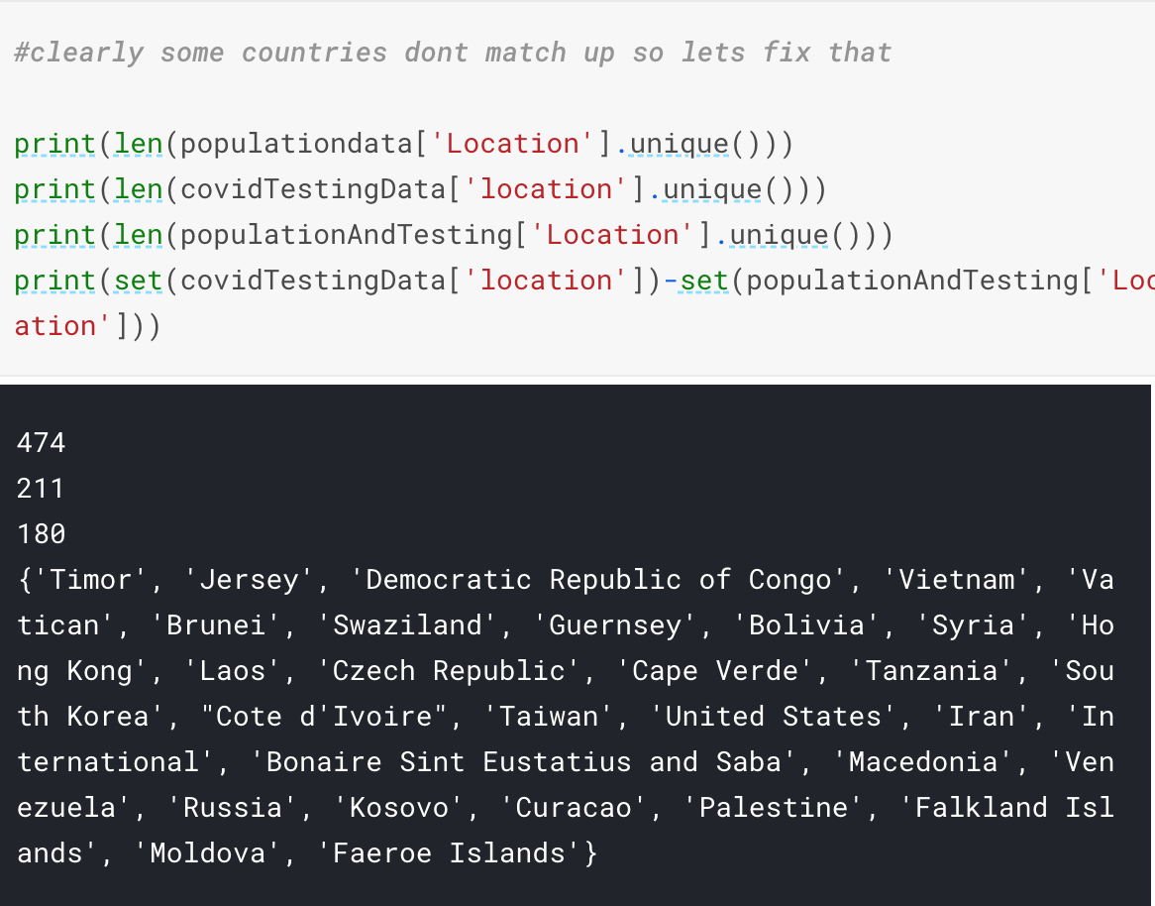
Data cleaning
One of the biggest early hurdles was that the data coming from different sources could not be easily joined
Many countries had different naming conventions between datasets, and there were large chunks of mismatching time frames.
Further, many countries had not reported some of their data (or seemed to have misreported it, such as China).
Some solutions: remove outliers and impute values

Slide 6
Variable Creation
Problem: Even after the data had been successfully merged and cleaned, the datasets were still not comparable.
This is consistent with media reporting – we often see comparisons of numbers from countries with vastly different population sizes and volume of testing.
In order to draw meaningful conclusions, we had to standardize the deaths, confirmed cases, and number of tests performed

Slide 7
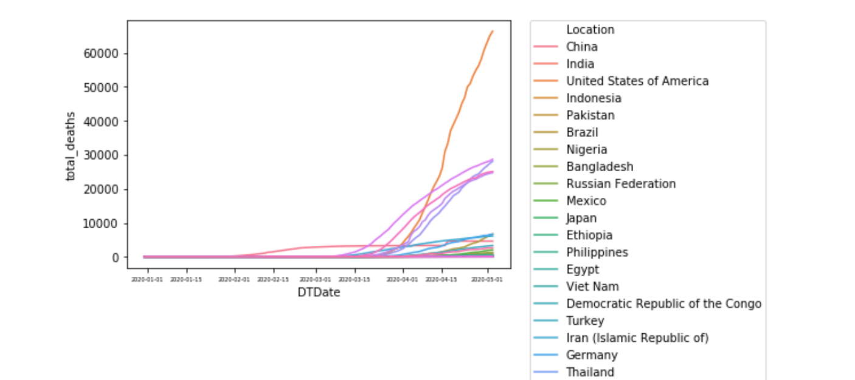
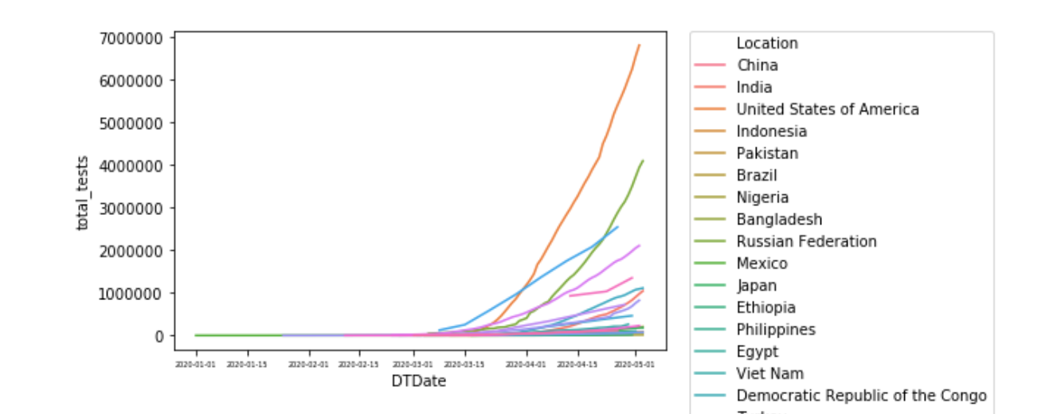
USA - Analysis
Deaths by Date
Total number of deaths from the USA was shown to be significantly higher than other countries.
This is partially explained by the fact that the USA is also testing significantly more people, relative to other countries, and is also the 3rd most populous country.
Tests by Date

Slide 8
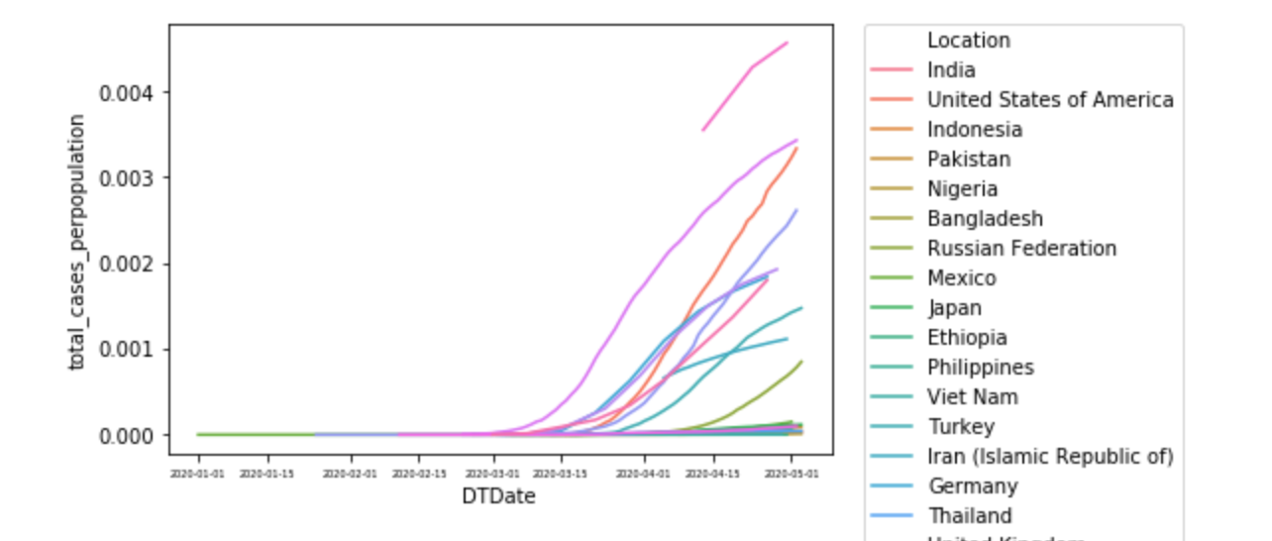
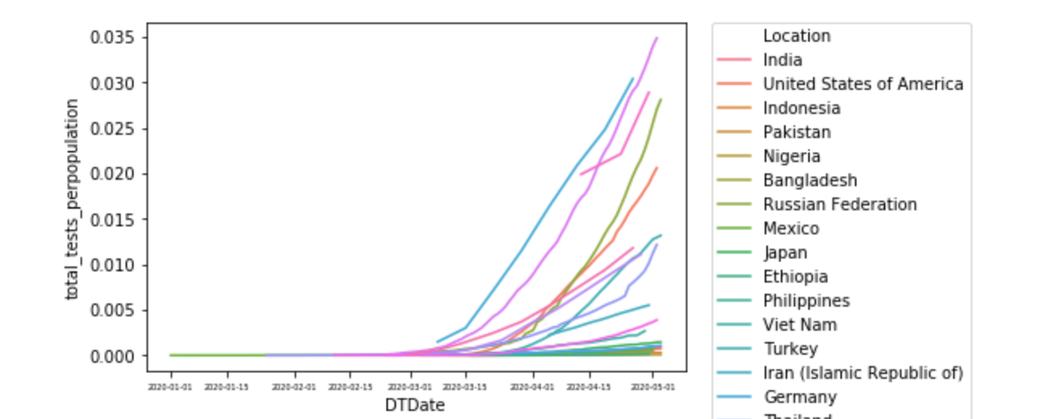
USA – STANDARDIZED
Total cases per population
By controlling for population, we see a drastic difference.
Total tests per population

Slide 9
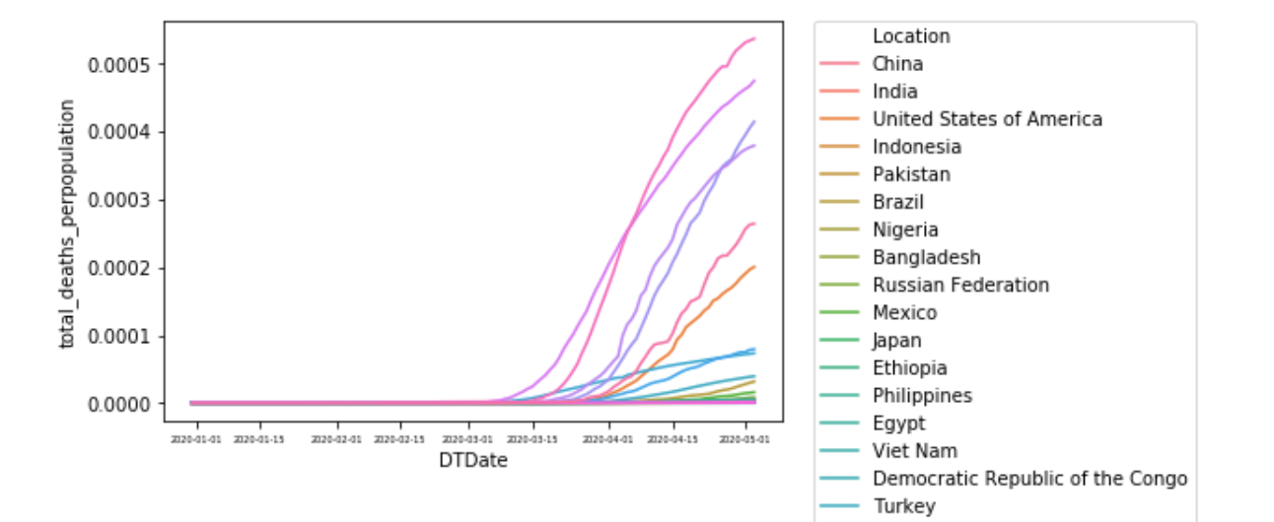
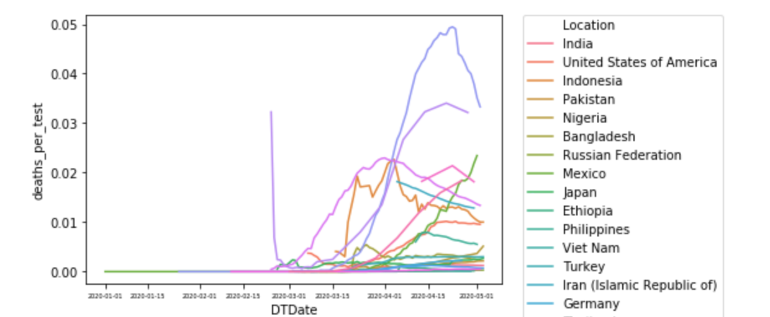
Usa –Standardized Cont.
Deaths per population
The deaths count looks drastically different when standardizing for population.
The most important metric is perhaps the deaths per people tested. Here we see a much more diverse mix.
This is expected as there are a lot of cofounding variables
Deaths per test

Slide 10
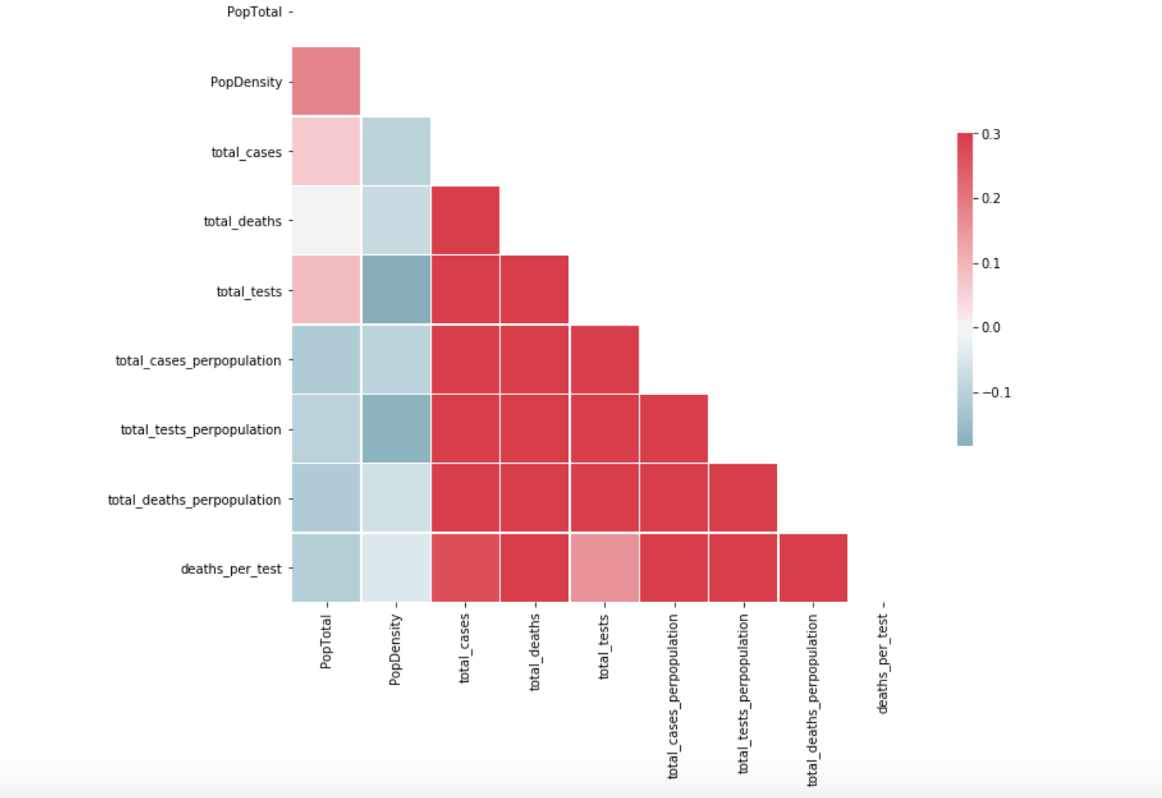
Interesting eda finding
Something we would expect in this analysis is a high correlation between population density and cases/deaths
In our analysis we don’t see this relationship

Slide 11
The Swedish approach
The way that Sweden has handled the COVID pandemic has been significantly different from most countries.
They have not shut down their economy or enforced any lockdown strategies.
We took a deeper dive and did a comparative statistical test to see if Sweden is faring markedly different from other countries.

Slide 12
Swedish results
Because Sweden is among the nations with a more developed healthcare system, it is not meaningful to compare it to less medically-advanced countries.
Instead, we took a subset of the highly developed countries (based on Gini coefficient).
We split data into two groups: “Swedish” and “not Swedish,” and ran an ANOVA. From our results, we can say with confidence that the two groups are not the same. (ANOVA F-statistic 11.3 , p-value 0.00077)
ANOVA assumptions not necessarily met, but somewhat robust to departures given a large sample size.

Slide 13

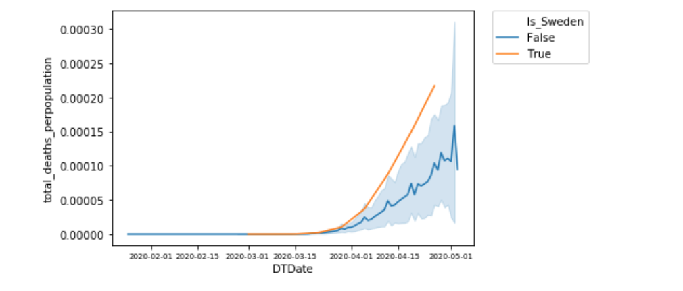
Sweden visual analysis
Deaths per population (Sweden vs Developed countries)
It is clear that Sweden is performing poorly compared to other developed nations in regard to Deaths per Capita.

Slide 14
Does WEATHER HAVE AN AFFECT ON COVID DEATHS?
We merged our weather data to our standardized dataset.
We then standardized all of our variables.
Finally, we ran a random forest on our data to predict Deaths per Capita, and Total Cases per Capita to investigate feature importance.

Slide 15
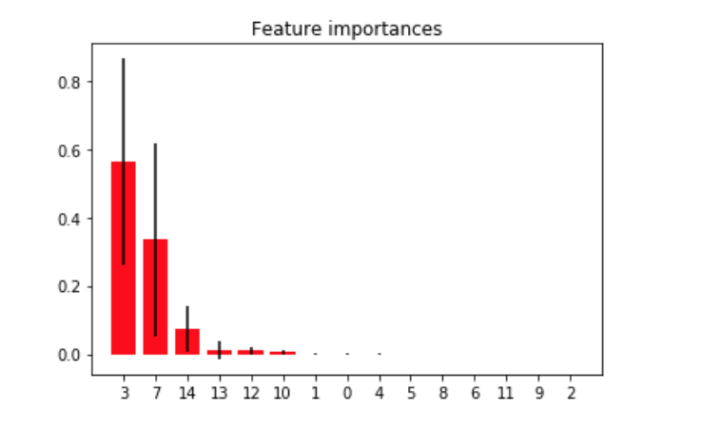
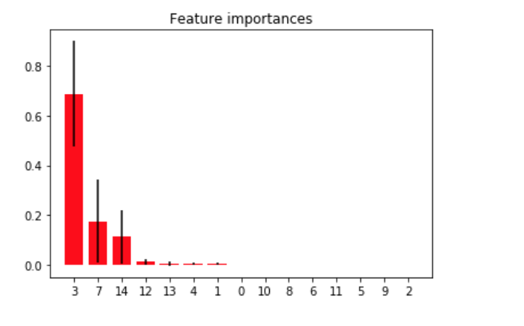
Results
As expected, the most important feature was time (the death count rises as time progresses).
However, another important feature in analyses of both Cases and Deaths was how hot the environment is.
It does seem weather has a mild effect.

Slide 16
Predictive modeling
With our scaled and cleaned weather data, we attempted to create a predictive model to see if we can accurately predict deaths per capita based on weather, time, and population.
Split the data 80-20 training testing and tested with 5-fold cross validation.
We ran three models:
Simple linear regression
Multi-level perceptron regressor
Model using Tensorflow

Slide 17
Results
Model | Linear Regression | MLP-Regressor | Tensorflow
RMSE | 0.010126698 | 0.0098778891209 | 0.0013097703126
All are relatively accurate but Tensorflow performed best.

Slide 18
QUESTIONS?

Slide 19
APPENDIX
https://population.un.org/wpp/Download/Standard/CSV/
https://github.com/owid/covid-19-data/tree/master/public/data
https://www.kaggle.com/davidbnn92/weather-data-for-covid19-data-analysis
https://www.kaggle.com/c/covid19-global-forecasting-week-4
https://www.kaggle.com/noaa/gsod
https://www.abs.gov.au/ausstats/abs@.nsf/mediareleasesbyCatalogue/CA1999BAEAA1A86ACA25765100098A47
https://www150.statcan.gc.ca/t1/tbl1/en/tv.action?pid=1710000901
http://data.stats.gov.cn/english/easyquery.htm?cn=E0103
https://www.census.gov/data/tables/time-series/demo/popest/2010s-state-total.html

